Slide 1
Android Build Times & APK Sizes
Jon Peppers 🌶️
Engineer, Xamarin.Android, Microsoft

Slide 2
Hello, nerds! 🤓
(term of endearment)

Slide 3
Why am I even here?
What do all these checkboxes mean? Linker, AOT, LLVM, Dex compiler, Code shrinker, 🤦etc.
Which settings are for Debug versus Release?
Tips & Tricks (and new features)
If you focus more on iOS – hopefully still useful!
Notes:
Not a lot of demo in this talk – hopefully not too boring, see my talk tomorrow

Slide 4
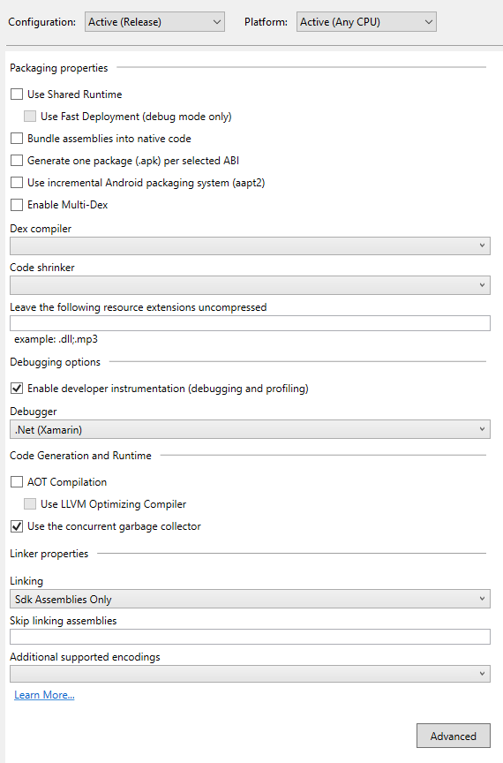
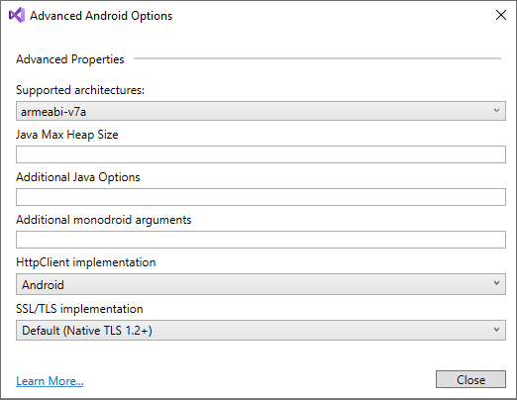

Slide 5
Which settings are important?

Slide 6
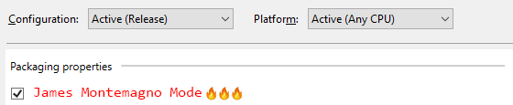
Understand what it does!!!

Slide 7
.NET: JIT vs AOT
What even are these? I literally can’t even.

Slide 8
C
x86 assembler
 | global _main
 | extern _puts
 | section .text
_main: | push rbx
 | lea rdi, [rel message]
 | call _puts
 | pop rbx
 | ret
 | section .data
message: | db "Hello, World", 0
 | #include <stdio.h>
 | int main()
 | {
 | printf("Hello, World!");
 | return 0;
 | }

Slide 9
C#
MSIL
 | .method static void main()
 | {
 | .entrypoint
 | .maxstack 1
 | ldstr "Hello, World!"
 | call void [mscorlib]System.Console::WriteLine(string)
 | ret
 | }
 | using System;
 | class Program
 | {
 | static void Main()
 | {
 | Console.WriteLine("Hello, World!");
 | }
 | }

Slide 10
 | global _main
 | extern _puts
 | section .text
_main: | push rbx
 | lea rdi, [rel message]
 | call _puts
 | pop rbx
 | ret
 | section .data
message: | db "Hello, World", 0
.NET is a Runtime
😕
JIT (just in time): each method is compiled to assembler on-demand
AOT (ahead of time): each method is compiled to assembler at build time

Slide 11
Pros & Cons
JIT
AOT
Smaller file size
Supports multiple CPUs
Slower startup
Bigger file size
Additional file size & build time per supported CPU
Faster startup

Slide 12

Linker
Strips and optimizes .NET code
Has a build time cost
SDK Assemblies Only – strips BCL, Xamarin.Android, and Xamarin.iOS framework assemblies
(Full) Sdk and User Assemblies – strips everything, but you may need to add exclusions for System.Reflection usage

Slide 13
ABIs = CPU architectures
armeabi-v7a – 32-bit arm devices, 64-bit devices *can* run
arm64-v8a – 64-bit arm devices, now required by Google Play
x86 – Intel-based 32-bit CPU, fairly low market share, could be a ChromeBook or a HAXM/Hyper-V emulator
x86_64 – Intel-based 64-bit CPU
Release apps should just have armeabi-v7a+arm64-v8a unless you have a good reason
Debug mode, just leave the defaults

Slide 14



Slide 15
Debug vs Release

Slide 16
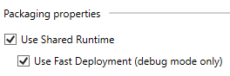
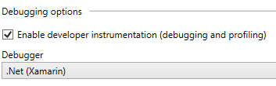
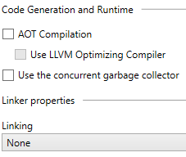

Debug “must-haves”

Slide 17
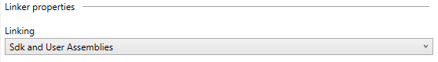
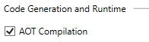
Optimal Release-mode

Slide 18
Other Settings
Multi-Dex – only turn on if your app hits the dex limit without it
There is a build-time cost
Use Multi-Dex checkbox for Debug mode
Consider a Code Shrinker for Release mode
LLVM
Only use for Release builds when you are already using AOT
Will create smaller and faster native code
Build time cost

Slide 19
Tips, Tricks, & New Features

Slide 20
DebugType=portable for Symbols
Set it to “portable” for Xamarin projects – that is basically all you need to know
Important for NuGet authors!!!
Otherwise there could be a build-time cost to convert to a format Mono supports
“full” is a proprietary Windows-specific format for Debug builds
“pdbonly” is a Windows-specific format for Release builds

Slide 21
aapt2
aapt is the Android Asset Packaging Tool
Compiles & converts resources, assets, packages the base of an APK
aapt2 is the “next generation” replacement
Has explicit “link” and “compile” steps to make incremental builds faster
More useful for “classic” Xamarin.Android apps

Slide 22
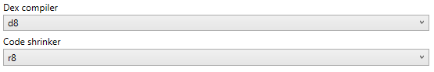
D8 & R8 – next generation DEX compilers
Android apps run Java, but use a different VM that has its own bytecode format
In the past DX, compiled Java bytecode to DEX (Dalvik EXecutable)
D8 is faster than DX, can produce smaller code
R8 is faster than using DX+ProGuard or DX+Multi-Dex

Slide 23
~5 seconds off build time
Enabled D8
Disabled Multi-Dex
DebugType=portable

Slide 24
Enabled D8 + R8
Disabled Multi-Dex
AOT

Slide 25
Questions?

